Slide 1






01
LOGIS
TICS
DELIVERY PREDICTION
By Jack Motta

Slide 2

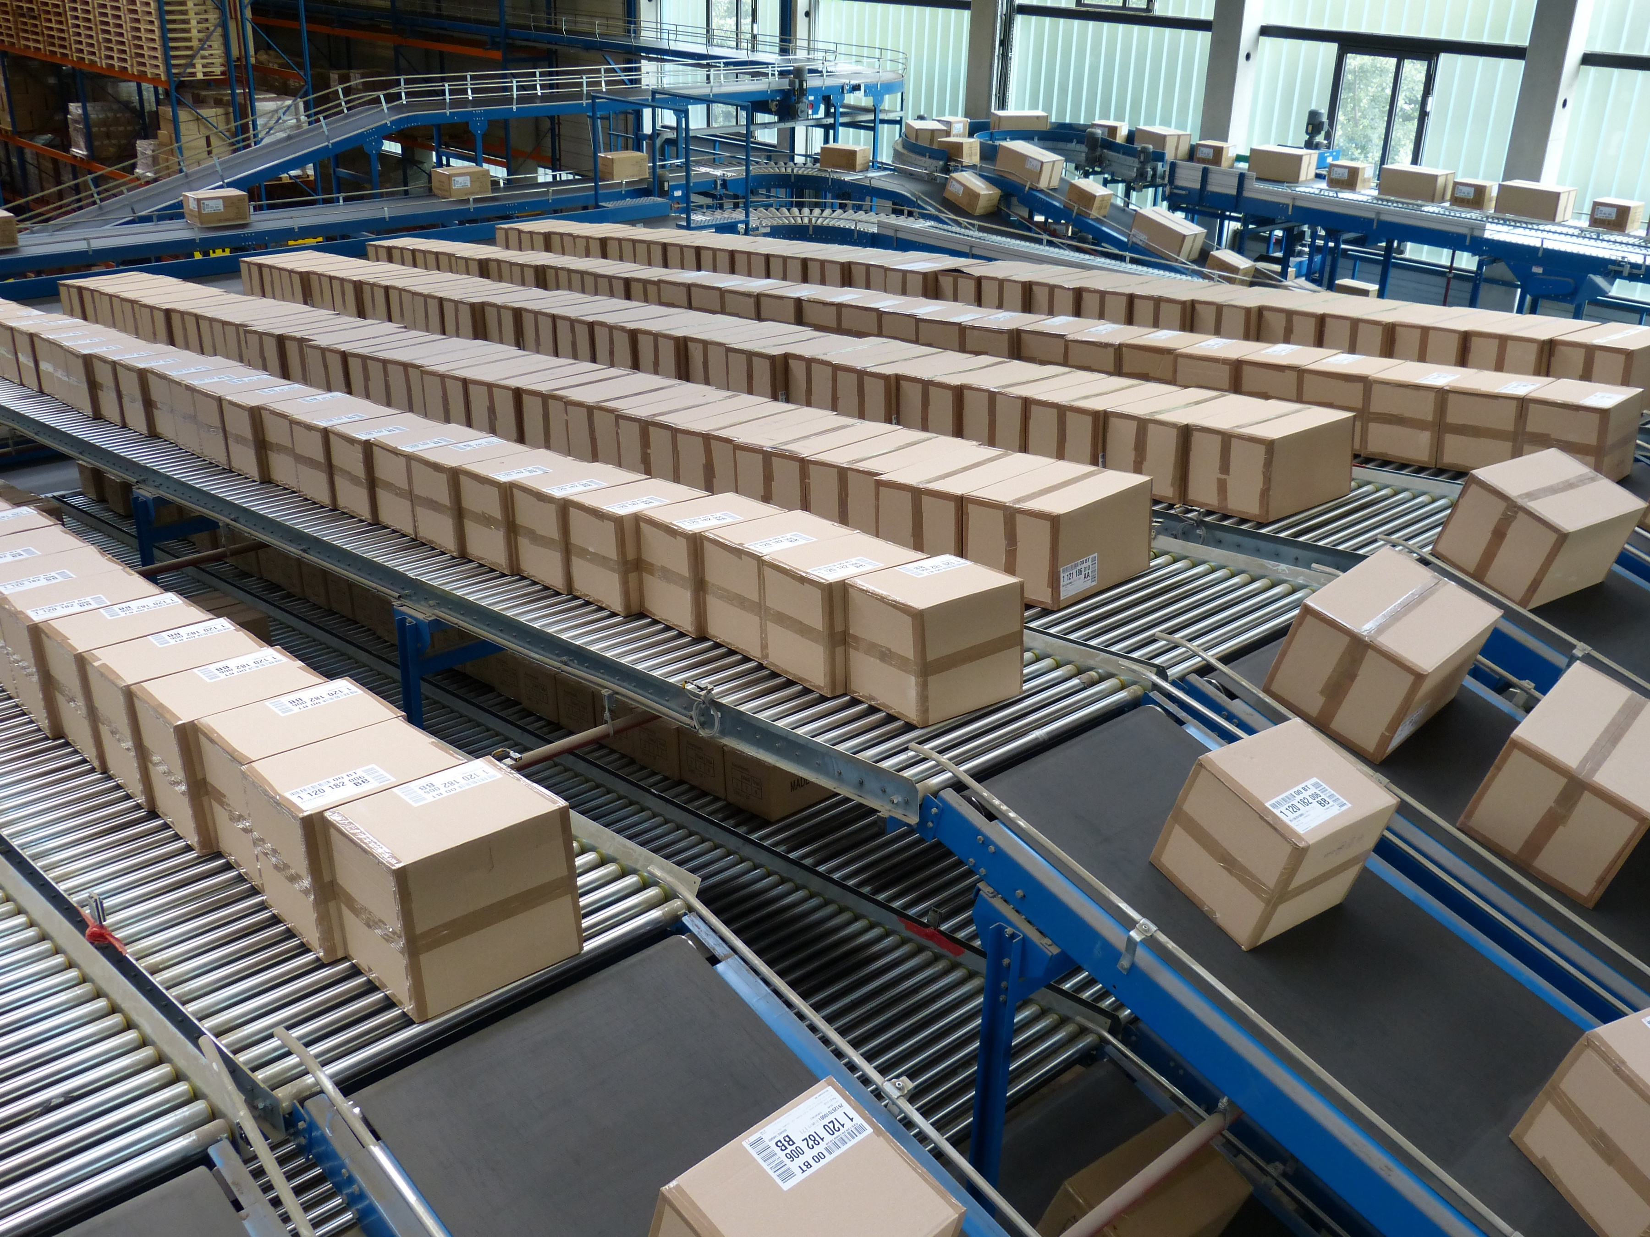
02
Introduction
Objective: Improve customer satisfaction by capturing delayed deliveries.
Prediction over interpretation.
Why It Matters: Delays hurt efficiency, cost, and customer satisfaction.
Data Sources:
Primary: Kaggle logistics dataset (2014–2018).
Secondary: U.S. diesel prices (2014–2018) from EIA.
Target: Delivery outcome.
Primary Performance Metric: Recall, balanced with precision and F1 score to avoid over-flagging.
Problem Type: Classification using pre-shipping info.

Slide 3
03
Background
Key Challenges in Delivery Performance
Lead Time Variability (Rokoss et al., 2024)
External Disruptions: Traffic, weather, and fuel prices (Ivanov & Dolgui, 2020)
Role of Predictive Analytics
Builds supply chain adaptability and recovery
ML models find patterns in past and external data (Gabellini et al., 2024)
Boosts forecasting from demand to last-mile delivery (Pazoki et al., 2023)
Project Contribution
Applies machine learning to real-world delivery data
Supports smarter, data-driven logistics decision-making

Slide 4
Dataset Overview
04
15,549 rows, 41 columns
Key Variable Groups
Customer Info
Segment, ID, Location (city, state, country, zip)
Order Details
Order ID, Dates (order, shipping), Status, Region, Delivery Location
Product & Sales
Product ID, Name, Category, Department, Price, Quantity, Discount, Total
Geolocation
Store latitude/longitude, market, delivery state
Shipping Mode
Delivery outcome (label: -1 = early, 0 = on-time, 1 = delayed)
Diesel Price
66 NAs total (diesel price) after merging

Slide 5
05
04
Exploratory Data Analysis

Slide 6
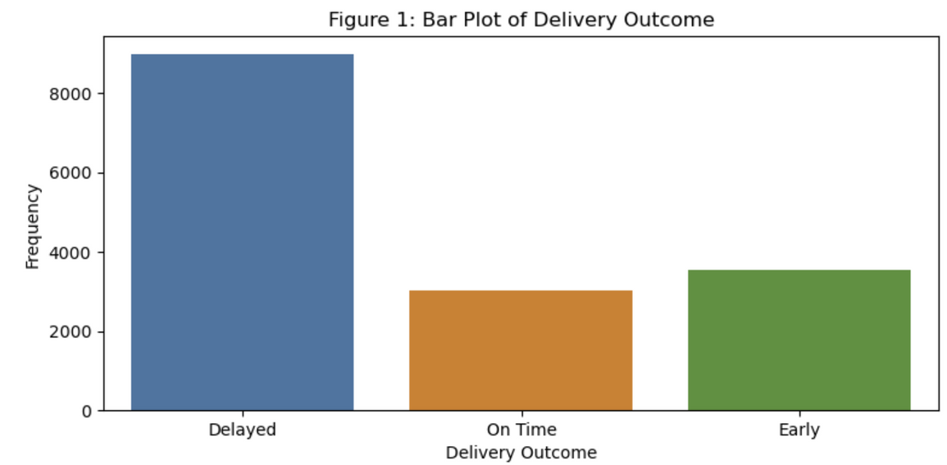
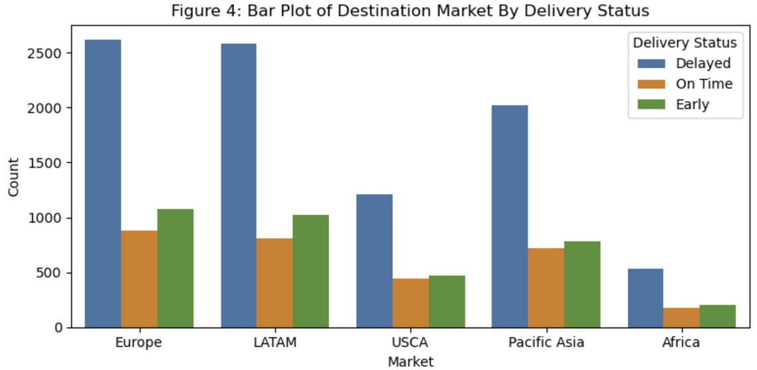
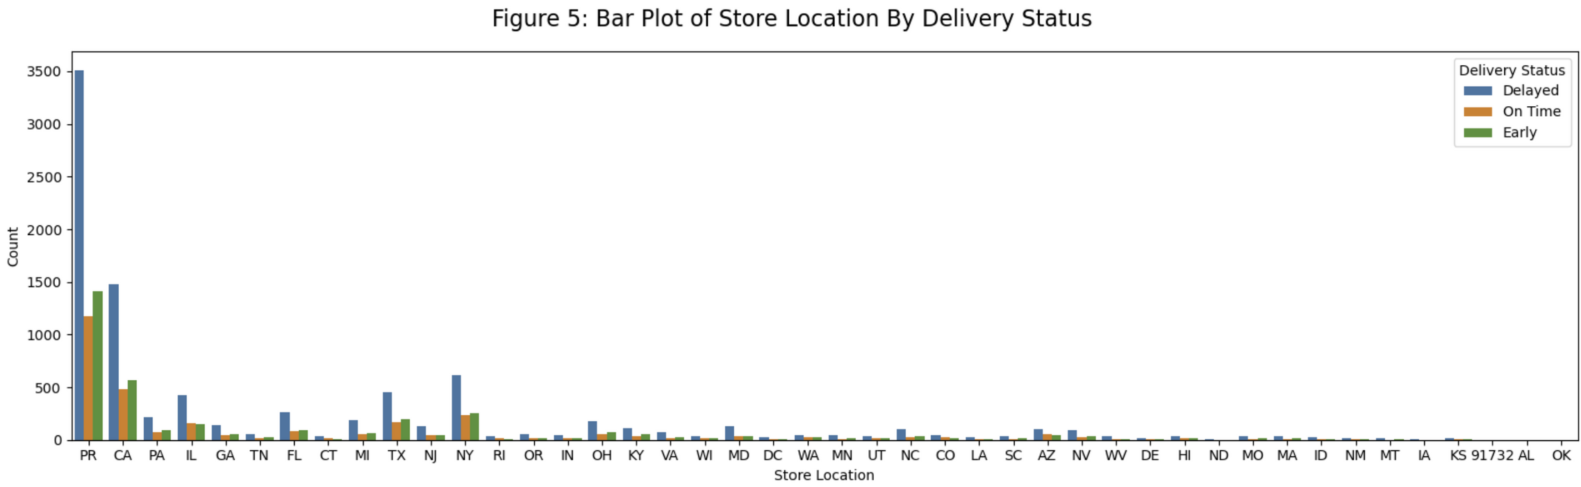
06

Slide 7



07
Preprocessing
Extracted weekend flag from order dates
Calculated shipping delay
Flagged and median imputed 5,941 invalid values (shipping date < order date)
Mean imputation on diesel prices
Corrected mislabeled state from ZIP code
Log and Yeo-Johnson transformation on skewed predictors

Slide 8
08
Preprocessing
Standardized numeric features
One-hot encoded low-cardinality categorical predictors
Ordinally encoded shipping mode
Label encoded delivery outcome as 0 (early), 1 (on-time), 2 (delayed)
84 predictors after preprocessing
70/30 stratified train-test split

Slide 9

09
Modeling
Models: Softmax Regression, Random Forest, XGBoost
Binary model of best multiclass model
Assumptions:
Softmax: Linearity not met → valid for prediction, not interpretation
Tree models: No assumptions → suited for mixed, nonlinear data
Tuning:
Grid search (5-fold CV) on all models
Tuned depth, learning rate, estimators, subsample, features

Slide 10
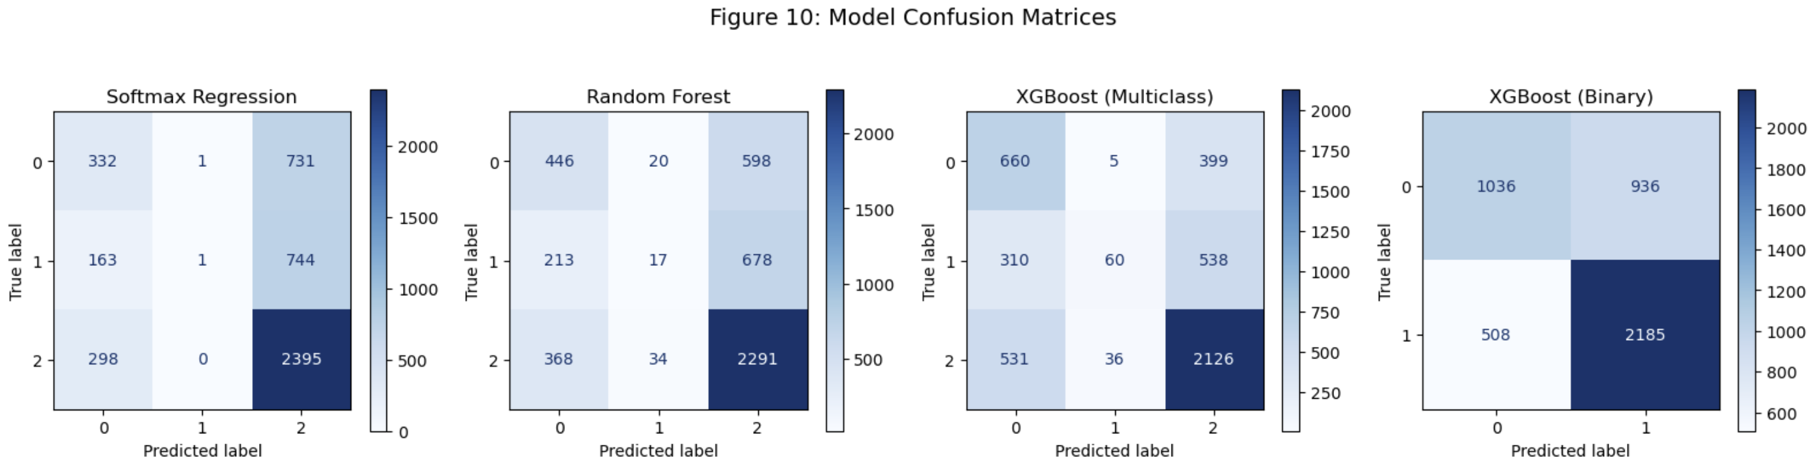
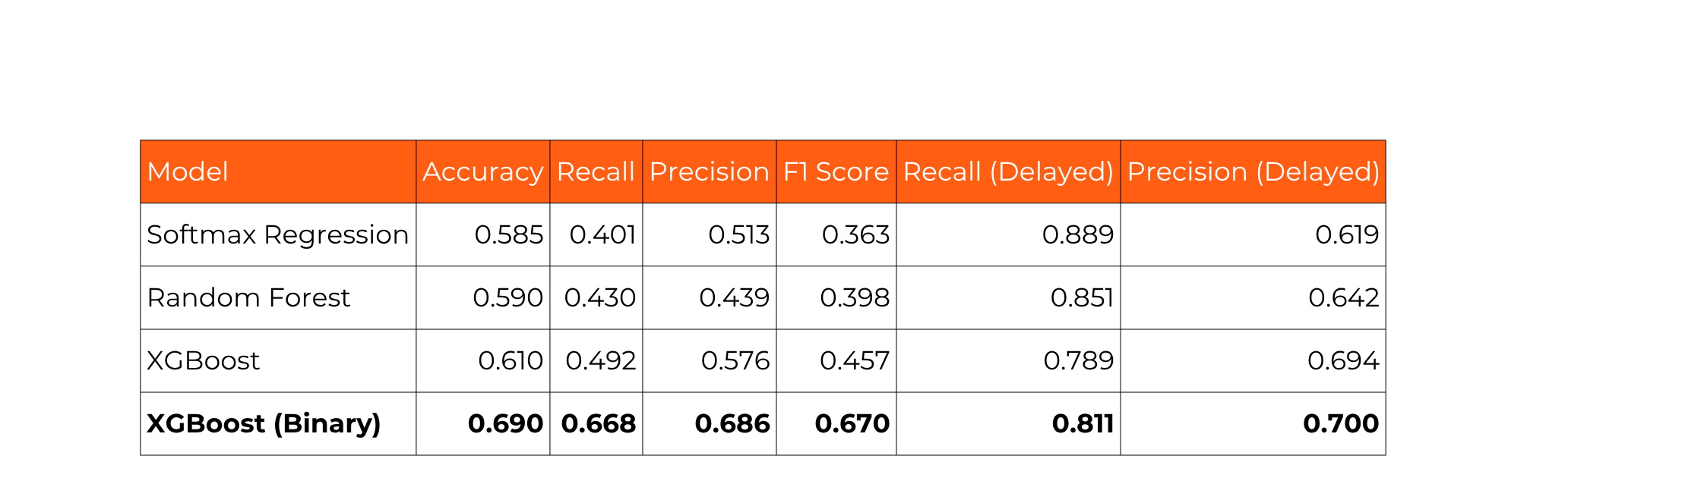
Results
10

Slide 11
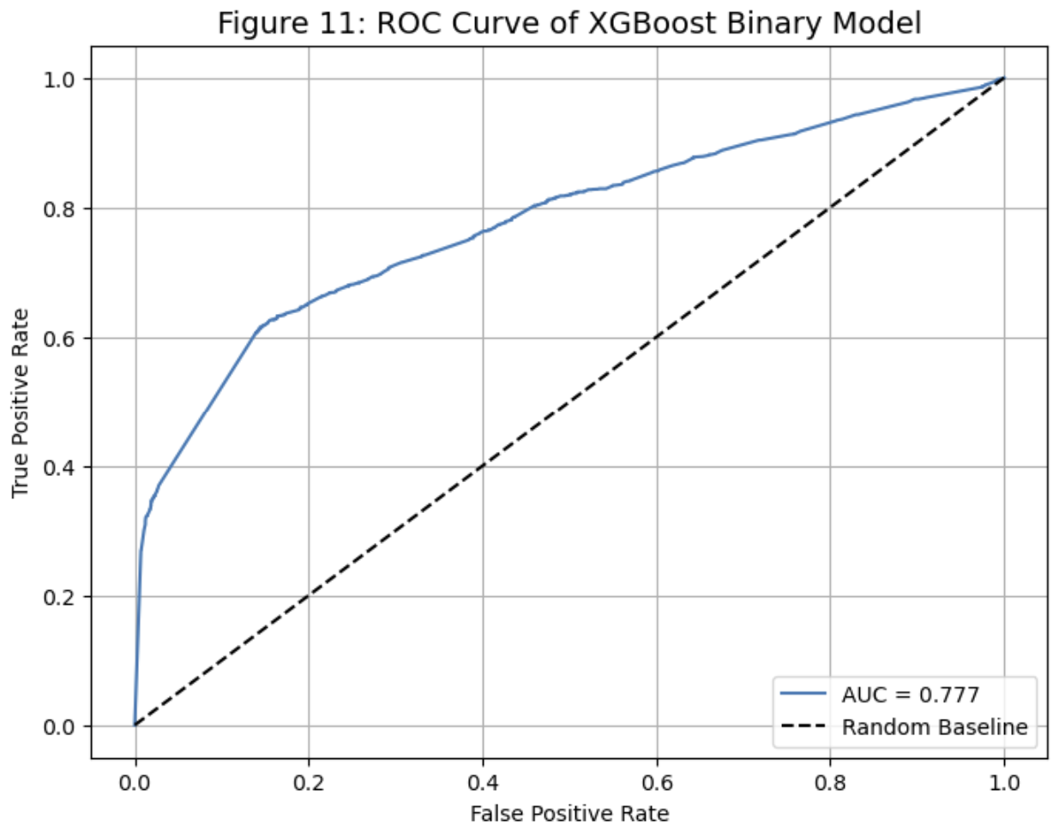
Results
11

Slide 12
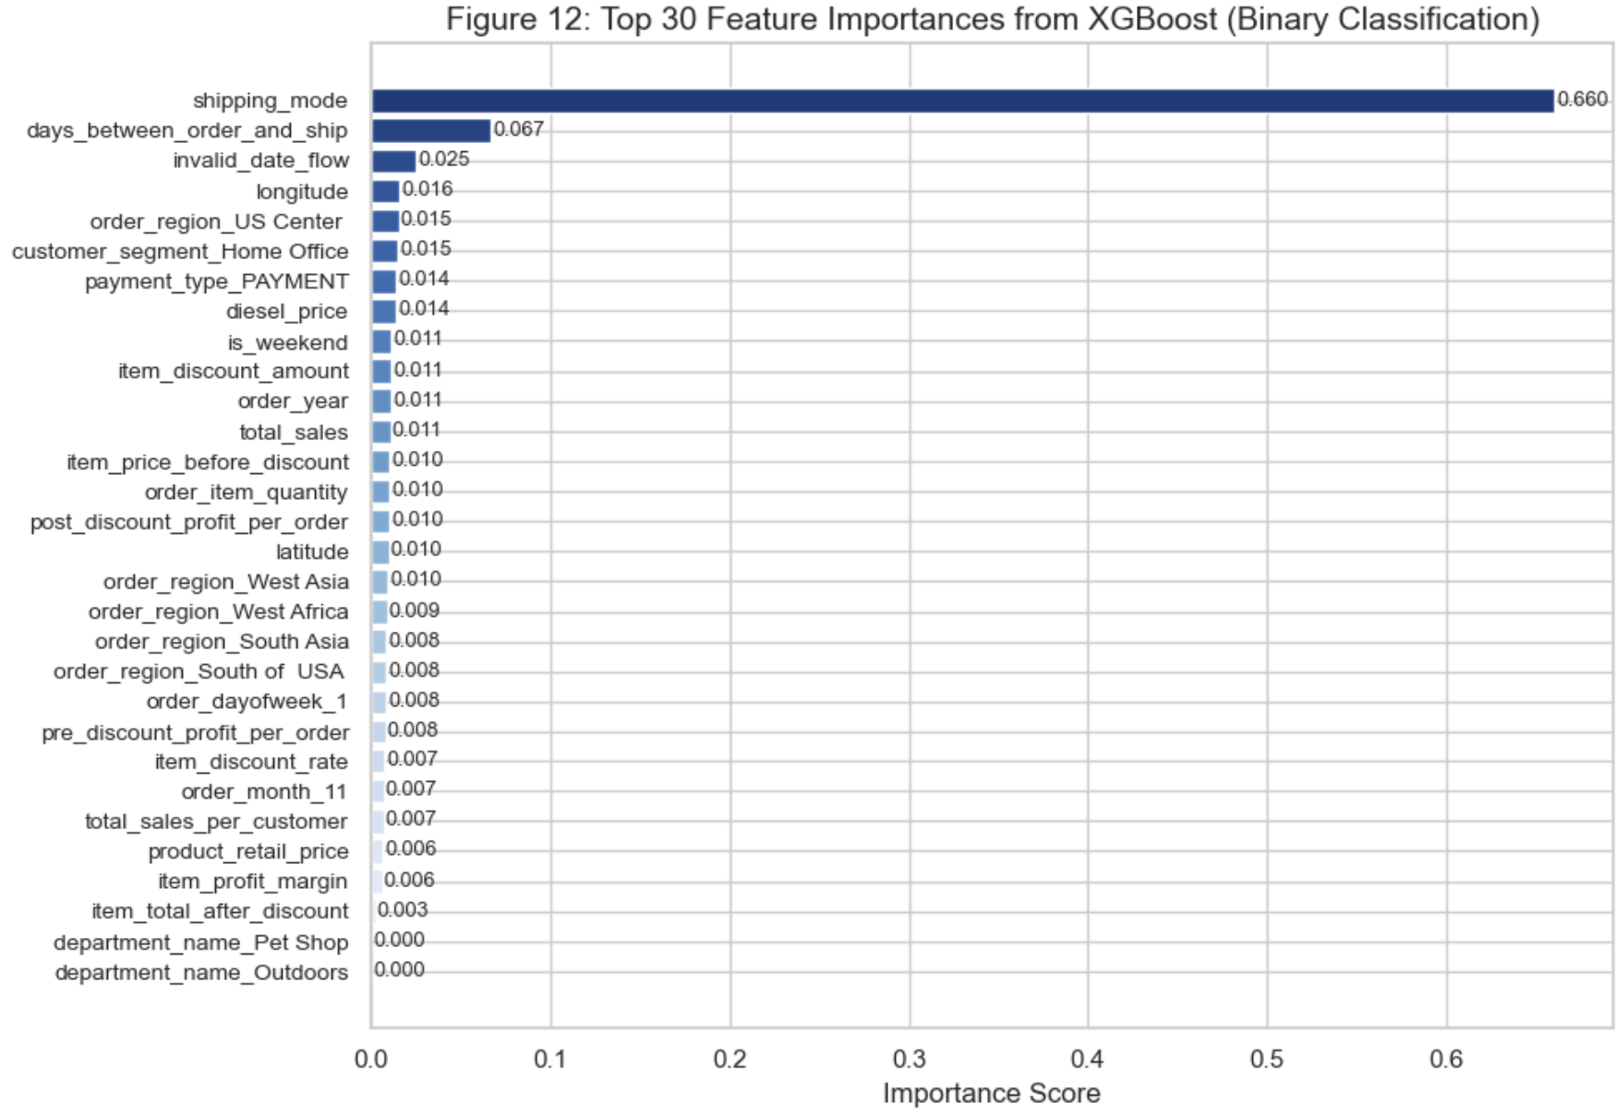
Results
12

Slide 13

13
Conclusion
Binary XGBoost predicted delays best (highest average recall)
Softmax underperformed due to non-linear data
Tree models handled mixed, complex features well
Improves delivery planning by flagging risks early, with room for refinement.
Next Steps
Remove low-impact features to reduce noise
Add fuel prices beyond diesel (e.g., jet, marine)
Merge rare categories to shrink feature space
Calibrate probabilities for better risk use
Use K-Means clusters to capture hidden patterns

Slide 14
References
14
Gabellini, M., Civolani, L., Calabrese, F., & Bortolini, M. (2024). A Deep Learning Approach to Predict Supply Chain Delivery Delay Risk Based on Macroeconomic Indicators: A Case Study in the Automotive Sector. Applied Sciences, 14, 4688. https://doi.org/10.3390/app14114688
Ivanov, D., & Dolgui, A. (2020). A Digital Supply Chain Twin for Managing the Disruption Risks and Resilience in the Era of Industry 4.0. Production Planning & Control, 32, 775–788. https://doi.org/10.1080/09537287.2020.1768450
Pazoki, M., Samarghandi, H., & Behroozi, M. (2023, August 1). Increasing Supply Chain Resiliency Through Equilibrium Pricing and Stipulating Transportation Quota Regulation. https://doi.org/10.48550/arXiv.2308.00681
Rokoss, A., Syberg, M., Tomidei, L., Hülsing, C., Deuse, J., & Schmidt, M. (2024). Case Study on Delivery Time Determination Using a Machine Learning Approach in Small Batch Production Companies. Journal of Intelligent Manufacturing, 35, 3937–3958. https://doi.org/10.1007/s10845-023-02290-2
Administration, U. E. (2025, March 17). Weekly Retail Gasoline and Diesel Prices. United States. Retrieved March 23, 2025, from https://www.eia.gov/dnav/pet/pet_pri_gnd_dcus_nus_w.htm
Kamboj, P. (2024, September 2). Logistics Supply Chain Real World Data. Retrieved from https://www.kaggle.com/datasets/pushpitkamboj/logistics-data-containing-real-world-data

Slide 15


15
Thanks For Listening

